Slide 1
Pose Detection Application
Jiang Shan
21M14414
1

Slide 2
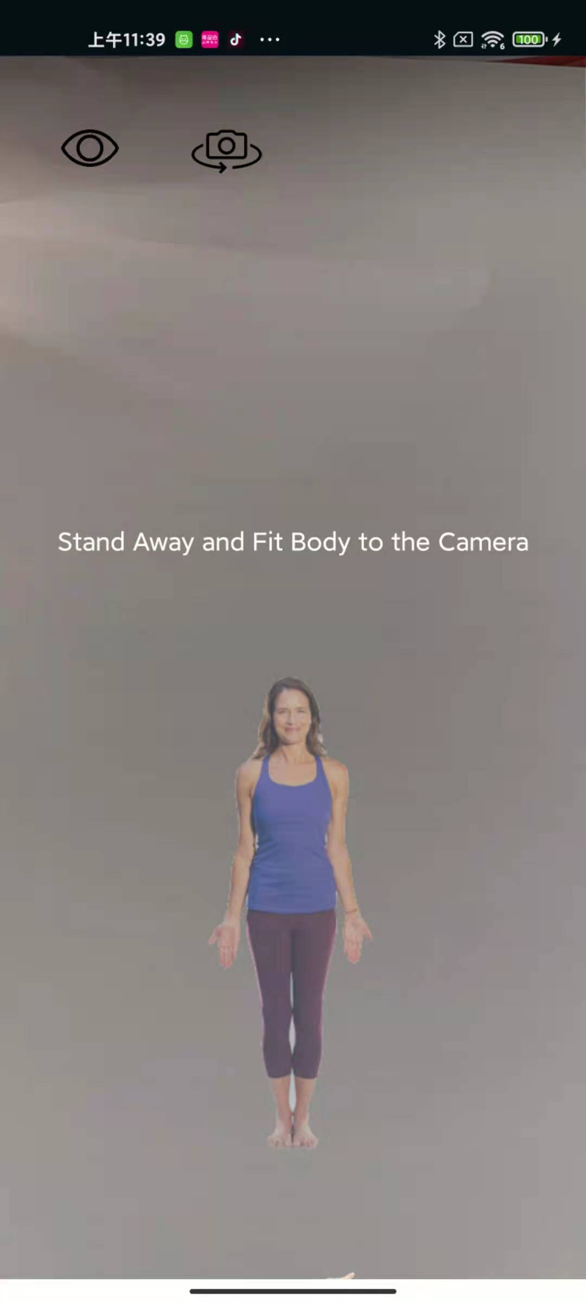
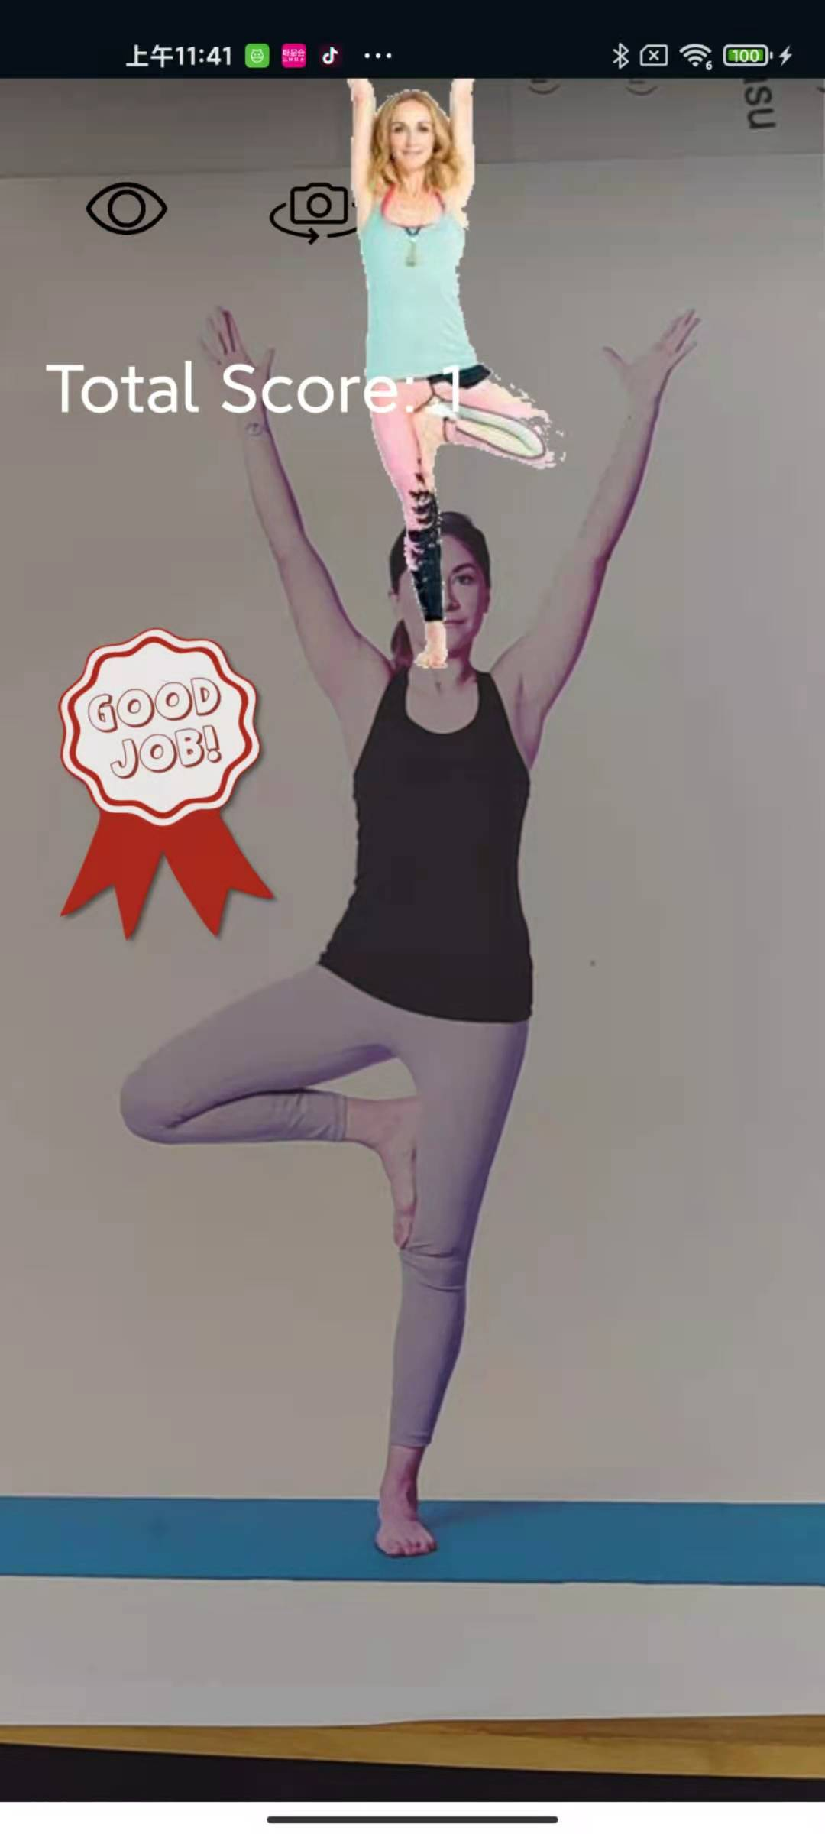
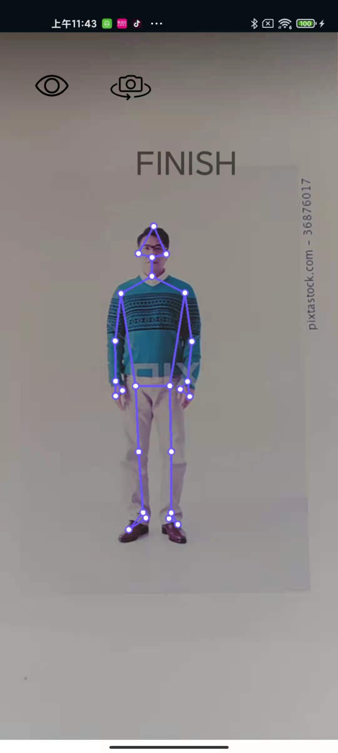
1. Application Feature
1. Use phone camera to detect human pose
Cast on TV to play
2. Follow pose animation
Increase exercise fun by doing the right pose to get scored
3. Illustrate main body joint
Check pose correctness more accurately
2

Slide 3
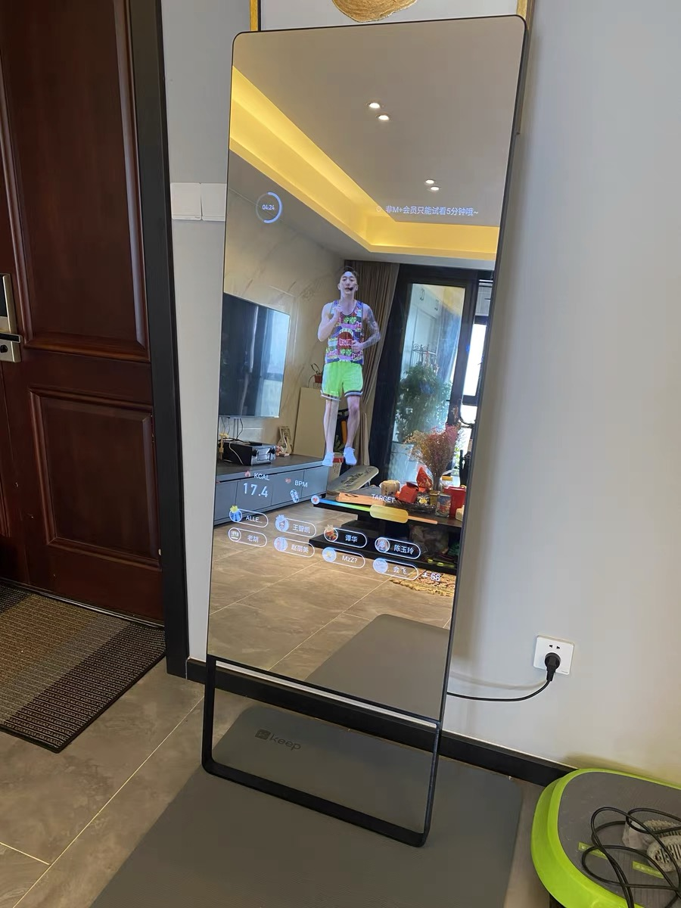
2. Motivation
Workout at home
Open tutorial video on YouTube on phone and cast on TV
-Unable to check my pose if there’s no mirror nearby
-Workout mirror is expensive and tutorials are limited
3

Slide 4
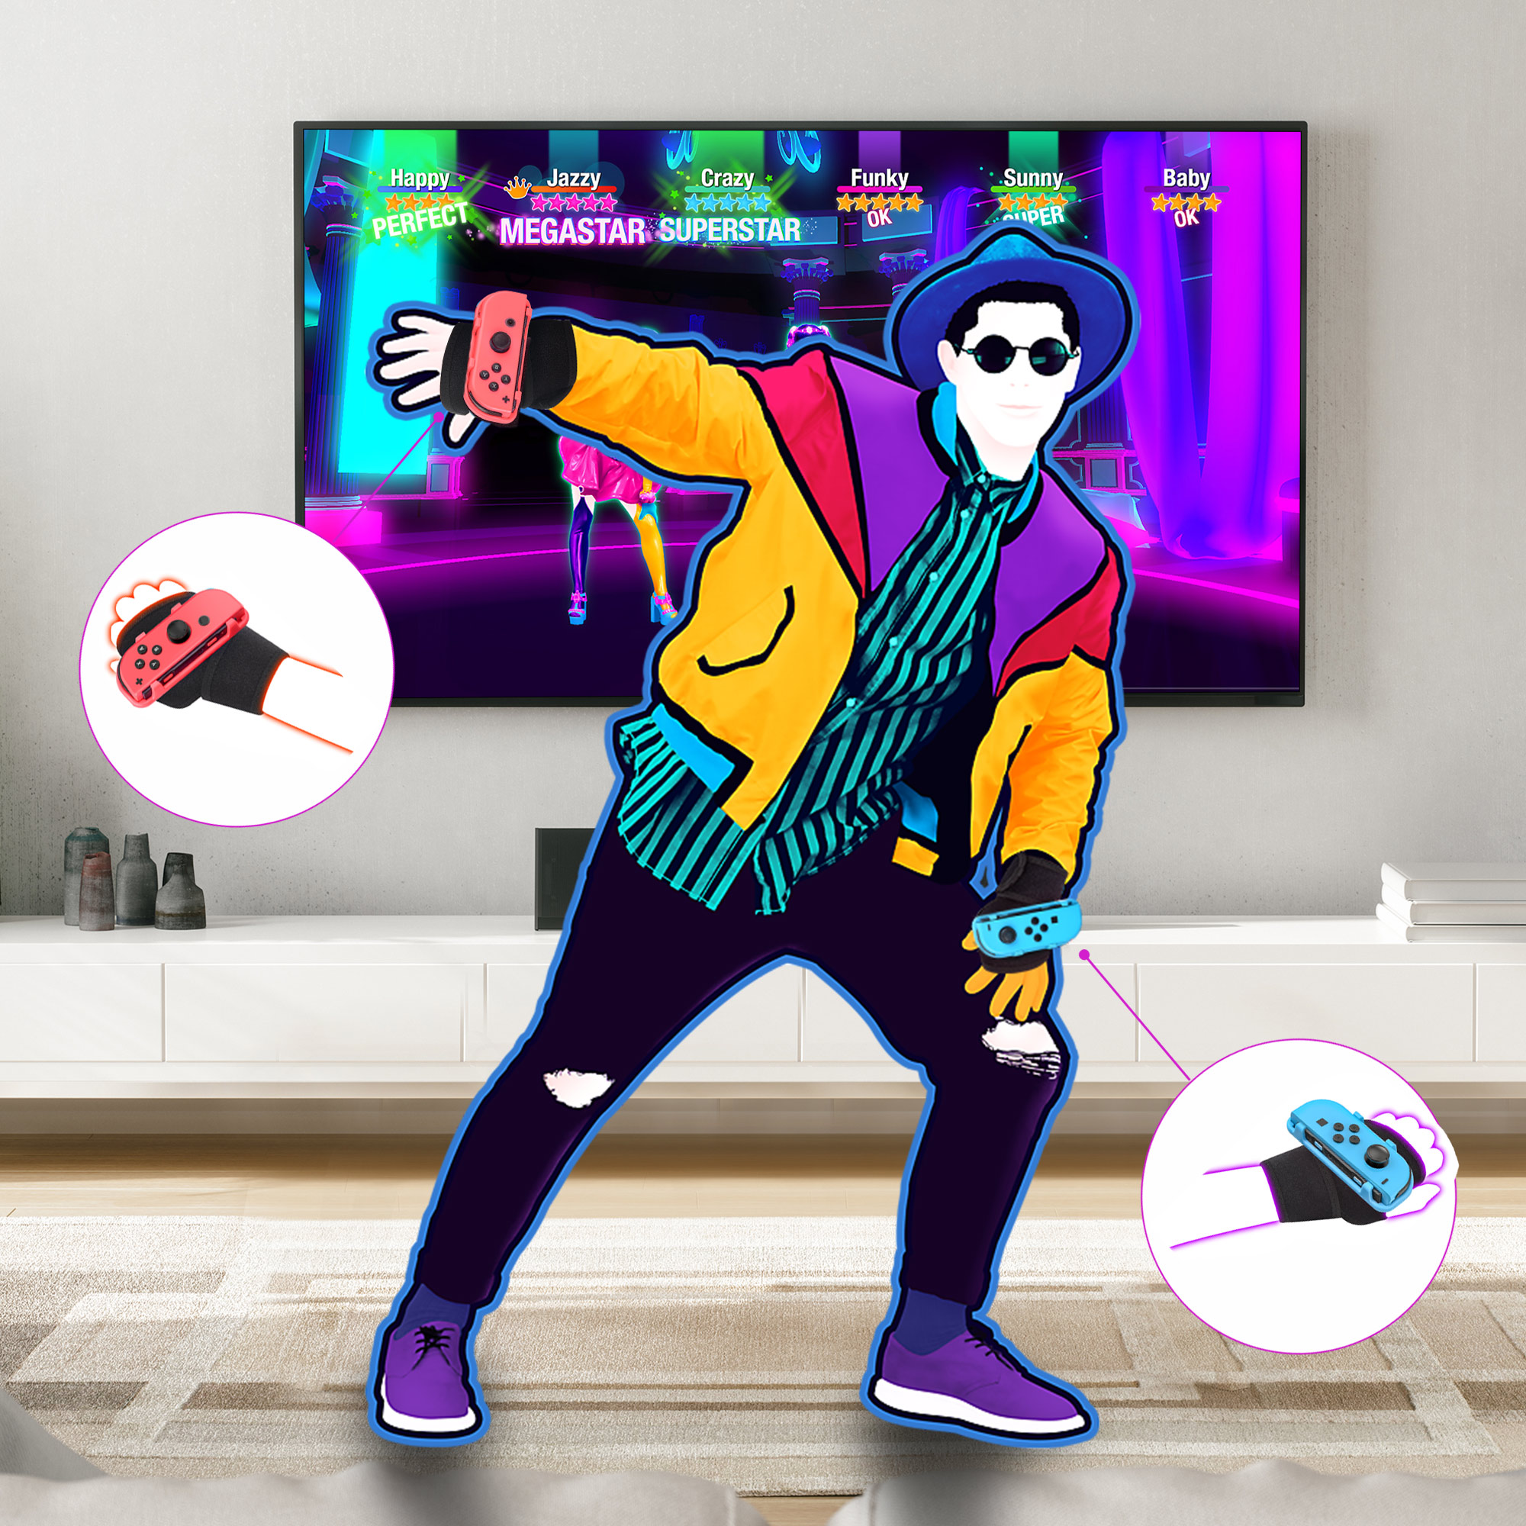
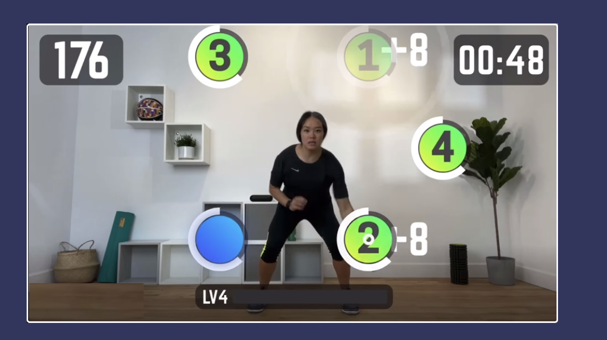
2. Motivation
Motion Sensing Games to play with family and friends
Motion Game like Nintendo Just Dance using Hand Grips and are much enjoyed at family reunion
-Need to have a Switch at first, not accurate for playing sports game
-Some Motion Games using Phone Camera add fun for exercise
4

Slide 5
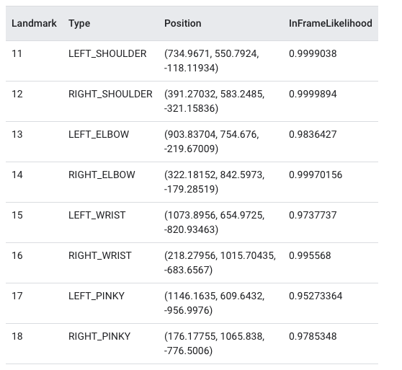
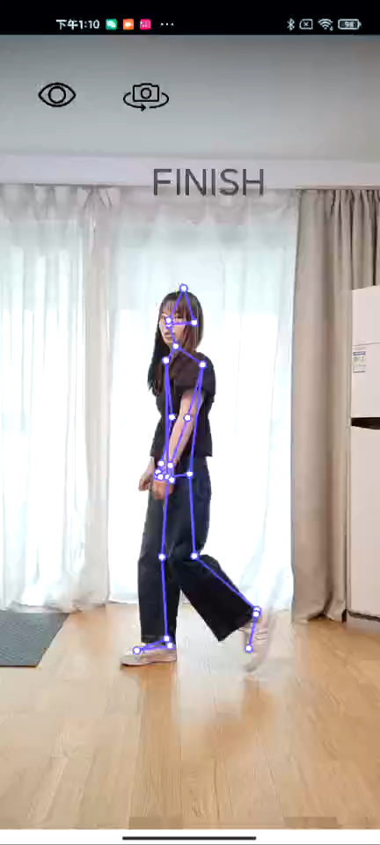
3. Details
Pose Detection Using Phone Camera
-ML SDK
Pose Recognition
-Relative Position
-k-nearest neighbors algorithm (k-NN)
5
Notes:
Google ML Kit

Slide 6
3. Details
Camera API
camera.setPreviewCallback
-Installs a callback to be invoked for every preview frame in addition to displaying them on the screen.
onPreviewFrame(byte[] data, Camera camera)
-NV21 data arrary
android.opengl.GLSurfaceView
-Create SurfaceView on Top of Camera View
6

Slide 7
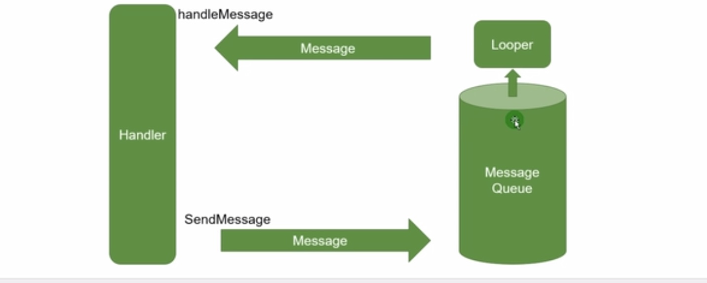
3. Details
UI Update
- asynchronous task
Handler
()
- Animation
.animation()
7

Slide 8
4. Demo
8

Slide 9
Thank you
9

